Slide 1
OOP Programming Task

Slide 2
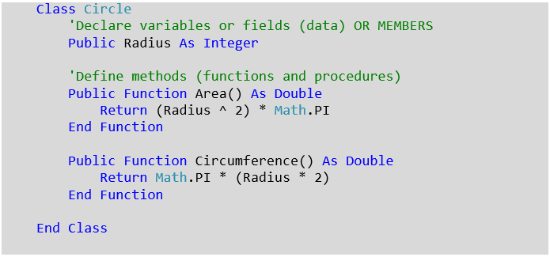
1
Create the following Circle class
Be aware of the difference between declaring functions and variables in Visual Basic
Use Math.Pow(variable, power) function instead of ^2
Do not worry that there is no constructor for this class yet!
Notes:
Note you do not need to create a constructor yet

Slide 3
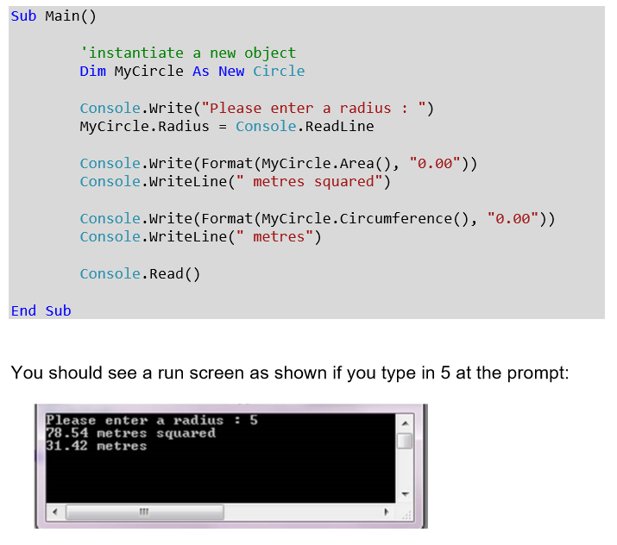
2
Test your program in Main
Note: to format a number to two decimal places see C# code below

Slide 4
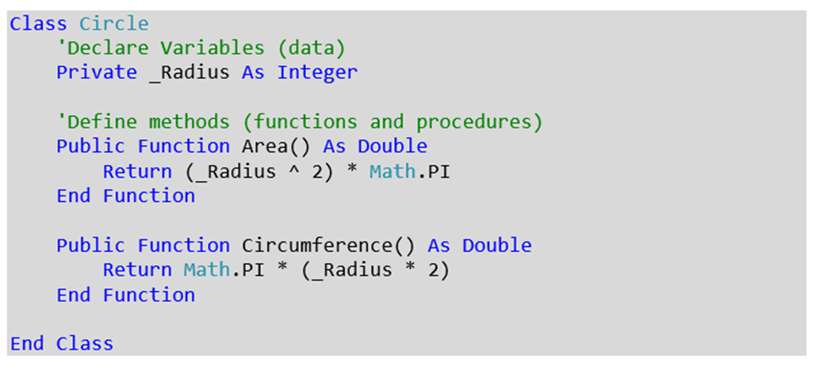
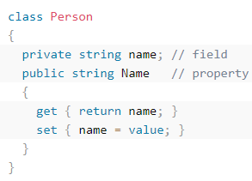
3
Change public status of _Radius to private
Which line of your code is now showing an error message?
Add a public get/set method to the circle class for _Radius
Run the program again to check the encapsulated class now works
HINT

Slide 5

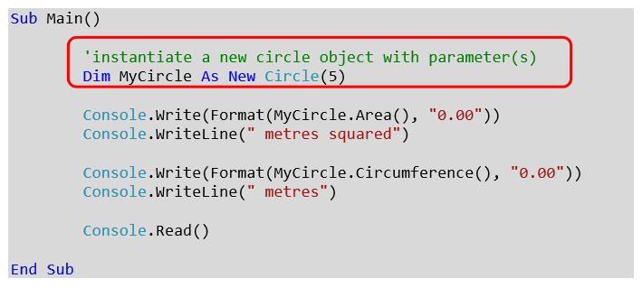
4
Create a constructor within the circle class which takes an integer parameter for radius and assigns it to private radius variable upon instantiation. (note another difference to C# - use of New instead of name of the class()
Test the new constructor from Main with the argument set to 5
You should achieve the same result as the previous test

Slide 6
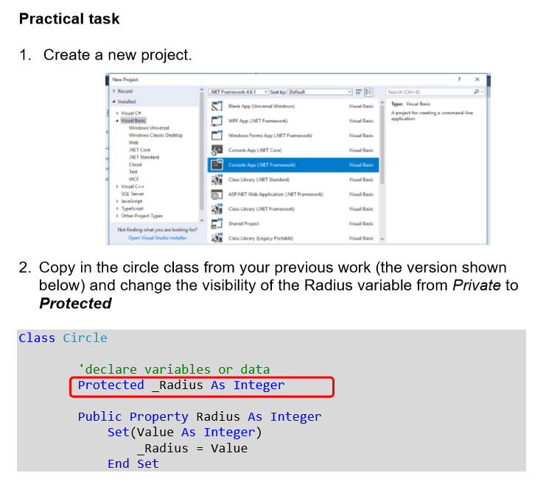
5
Part 2 is implementing inheritance into your program
Change the access modifier for _Radius to protected

Slide 7
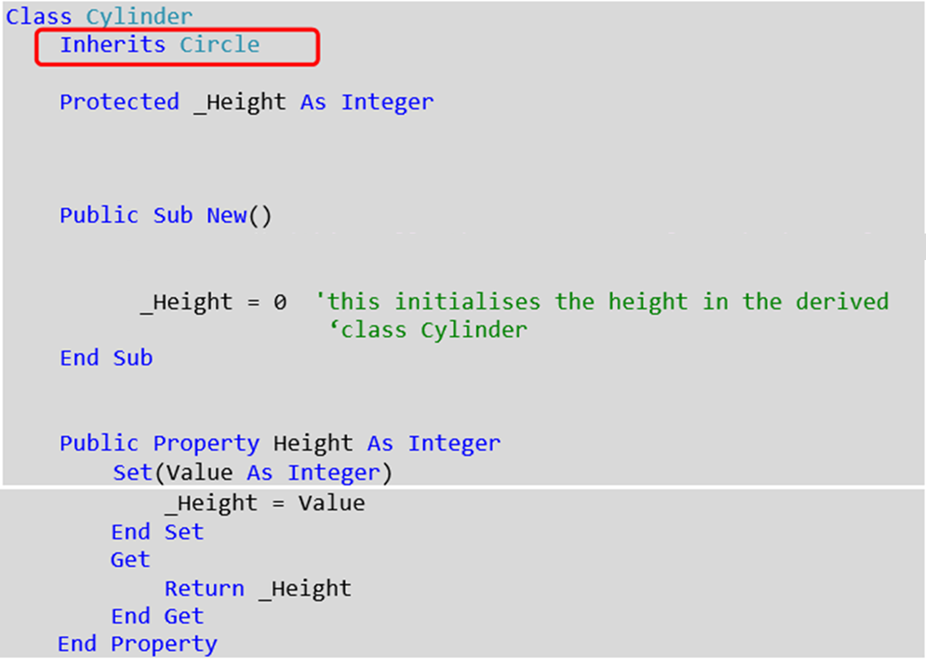
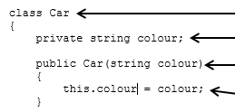
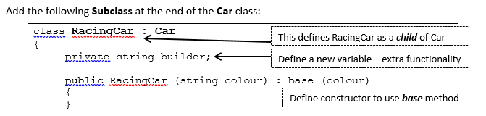
6
DIFFERENT IN C#
Create a new class called cylinder that inherits from circle, use the properties and methods shown in image.
Create a constructor that initialises _Height to 5. (NOT 0)
Hint: Image bottom right corner might give you ideas if you now have an error message !
You do not need to add a get/set method for _Height

Slide 8
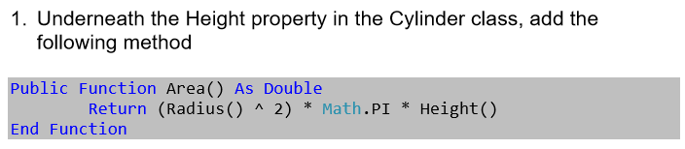
7
Create the following method in the cylinder class
Override the function Area in the circle class
You will need to use two C# command words to do this (virtual & override)

Slide 9
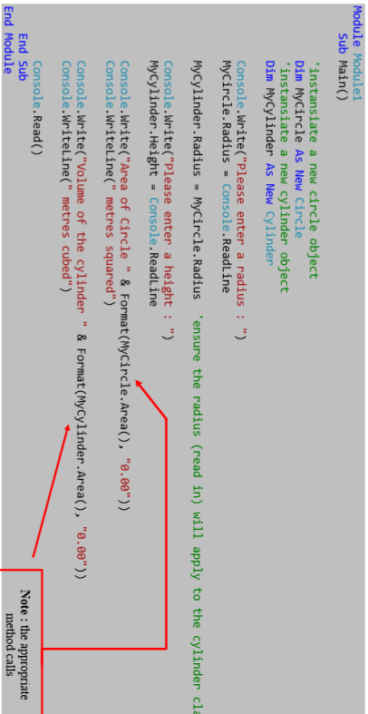
8
Update main method as follows;
Create a new instance of a cylinder called MyCylinder – use ‘3’ as the value for the radius.
Output to the console the area of the cylinder (see orange highlight)

Slide 10
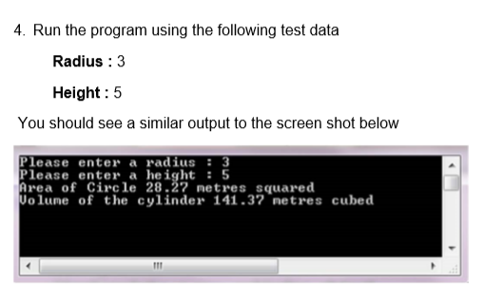
9
How did you do??
Ask the teacher to verify completion

Slide 11
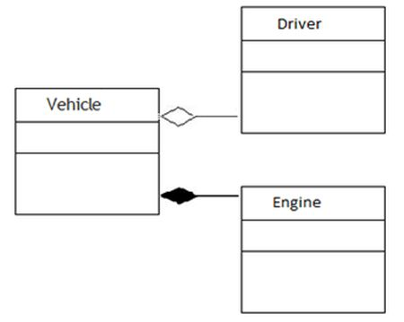
10
Favour composition over inheritance
Modify your cylinder program removing the inheritance you implemented
Implement a composition relationship
Which class acts as the containing class?
Reproduce the same screen shot as task slide 9
Ask teacher to verify completion

